Slide 1
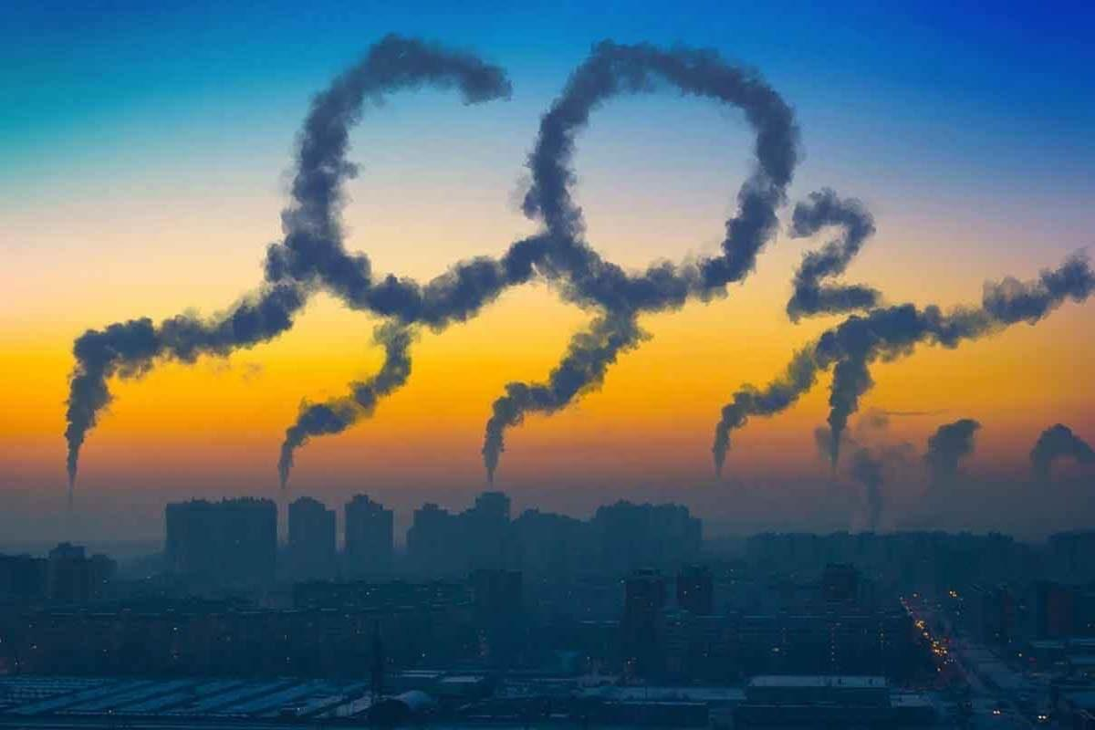
CO2 Emissions Flow Across Countries over the Decades:
An Animated Sankey Story
Project by:
Sayali Pawar, Dept of Computing, DCU
Vaibhav Thalal, Dept of Computing, DCU

Slide 2
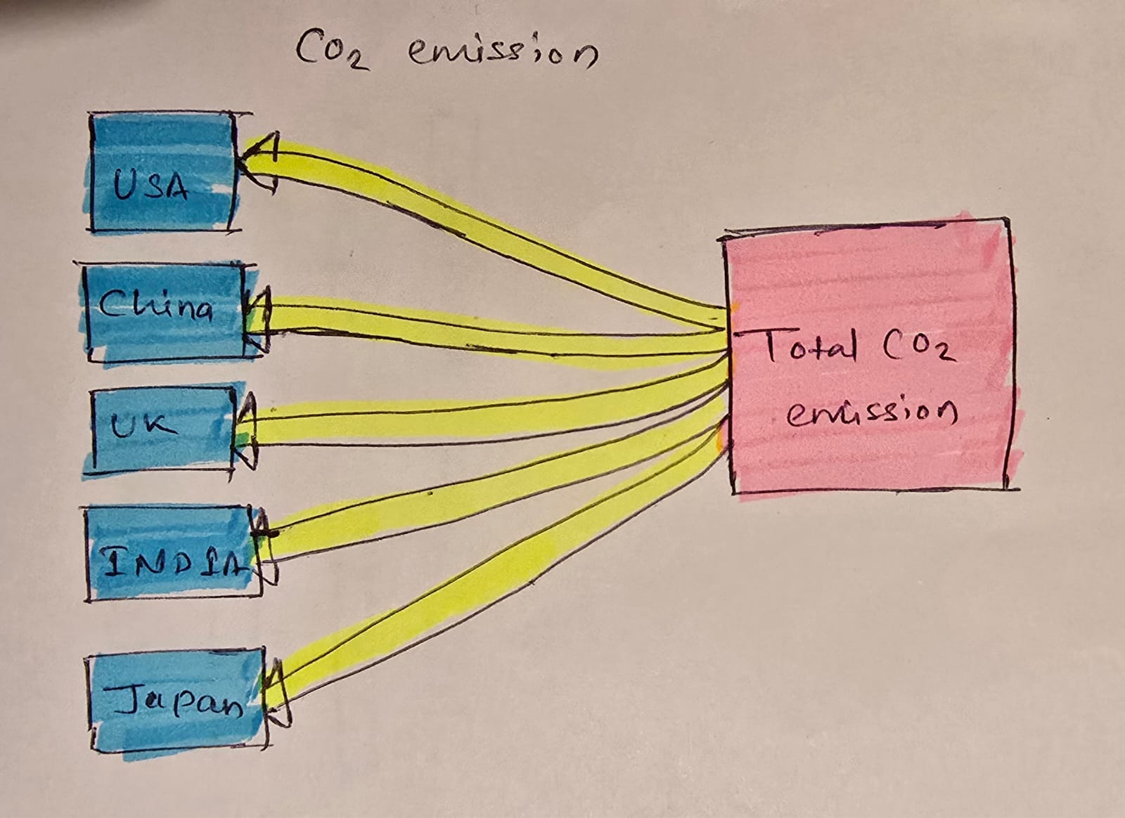
Design Process
Initial Sketch:
As per the dataset the columns we could consider for the Sankey plot in initial stage were.
Country
Total CO2 emission in KT
Project by:
Sayali Pawar, Dept of Computing, DCU
Vaibhav Thalal, Dept of Computing, DCU

Slide 3
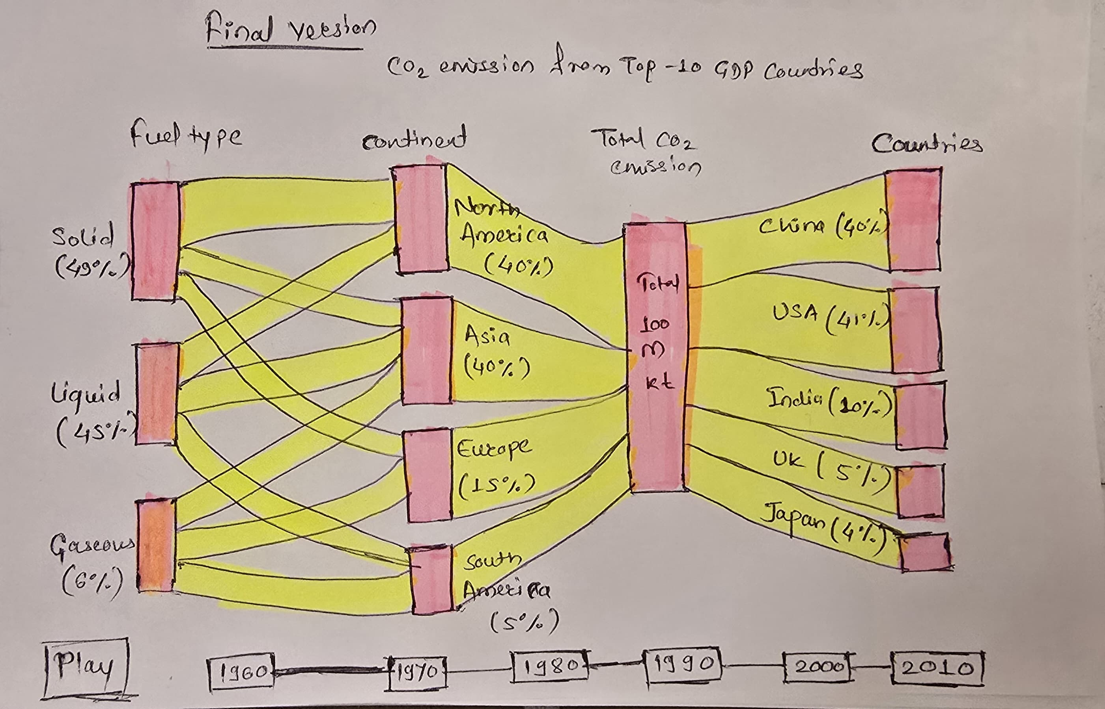
Design Process
Final Sketch:
We then investigated other Indicators related to CO2 emission in data.
We found out sources of CO2 emissions.
Fuel Type
Solid Fuels, Liquid Fuels and Gaseous Fuels.
We also created a custom column for continents of each country.
Also, we created the animation in graph by adding decade timeline at bottom.
Project by:
Sayali Pawar, Dept of Computing, DCU
Vaibhav Thalal, Dept of Computing, DCU

